Slide 1

PYTHON
DEMO CLASS

Slide 2
OVERVIEW
Python Introduction
Python Features
Python Application
Python Versions
The job market Scope in Python
Major Certification in Python

Slide 3
PYTHON INTRODUCTION
Python is simple
Easy to learn
Powerful Language
High Level Language
Object-Oriented Programming Language
Multipurpose programming Language
Designed to be Highly readable

Slide 4
PYTHON FEATURES
Easy to use
Expressive Language
Interpreted Language
Cross-Platform Language
Free and open source
Object-Oriented Language
Extensible
Large Standard Library
GUI Programming
Integrated
Databases
Portable
scalable

Slide 5
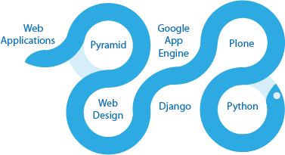
PYTHON APPLICATION
Console Based Application
Audio or Video based Applications
3D CAD Applications
Enterprise Applications
Applications for Images
Back end Web Development
Data Analysis
AI and Scientific Computing
Games Desktop Apps
Graphical User Interface

Slide 6
PYTHON VERSIONS
Python 2.7.15
Python 3.7.
Note:
Python 3.5+ cannot be used on Windows XP or earlier

Slide 7
THE JOB MARKET SCOPE IN PYTHON
Software Engineer
Data Scientist
Senior Software Engineer
Software Developer
Software Programmer
Development Operations(DevOps)

Slide 8
Your questions are welcome!

Slide 9
THANK YOU

